Slide 1

ICE 3161
COMMUNICATION ENGINEERING
Dr. Asif Zaman
Professor, CSE, RU

Slide 2
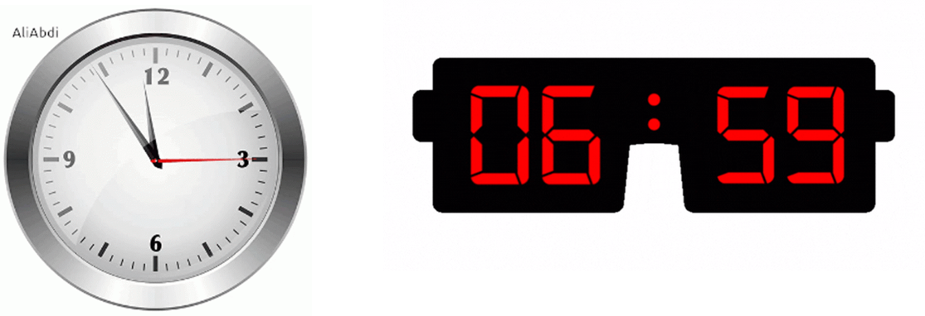
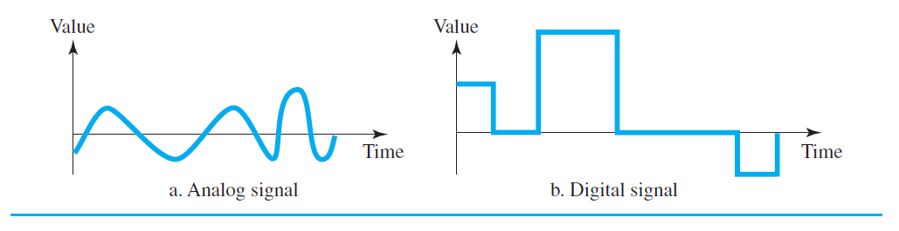
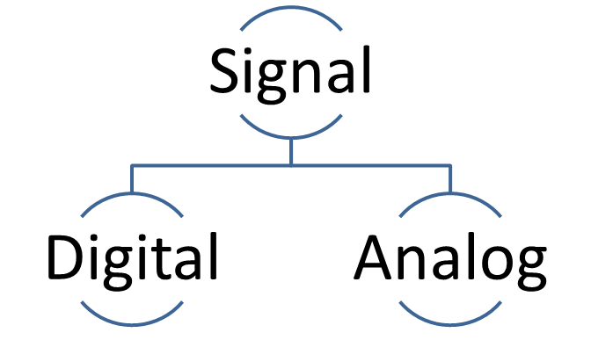
Digital Transmission
Data
Digital
Analog
How can we represent digital data by using digital signals?

Slide 3
Digital-to-digital Conversion
The conversion involves three techniques:
  line coding
  block coding
  scrambling
jhakuni

Slide 4
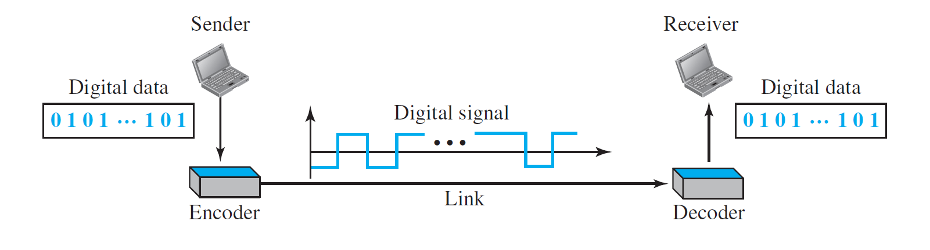
Line Coding
We assume that data, … are stored in computer memory as sequences of bits.
Line coding converts a sequence of bits to a digital signal.
At the sender: digital data are encoded into a digital signal;
at the receiver: the digital data are recreated by decoding the digital signal.

Slide 5
Line Coding
Characteristics
  Signal Element & Data Element
  Data Rate & Signal Rate
  Bandwidth
  Baseline Wandering
  Self-synchronization

Slide 6
Signal Element & Data Element
  A data element is the smallest entity that can represent a piece of information: this is the bit.
  A signal element is the shortest unit (timewise) of a digital signal.
  a signal element carries data elements.
  Data elements are what we need to send;
  signal elements are what we can send.
  Data elements are being carried;
  signal elements are the carriers.

Slide 7
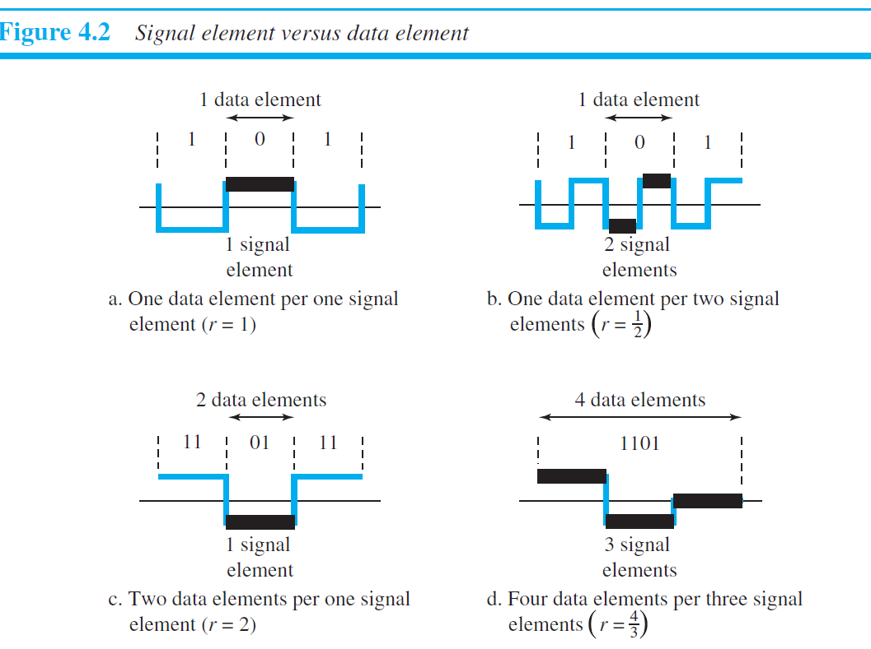
We define a ratio r which is the number of data elements carried by each signal element.

Slide 8
Data Rate Versus Signal Rate
The data rate defines the number of data elements (bits) sent in 1s.
The unit is bits per second (bps).
The signal rate is the number of signal elements sent in 1s. The unit is the baud.
pulse rate, the modulation rate, or the baud rate

Slide 9
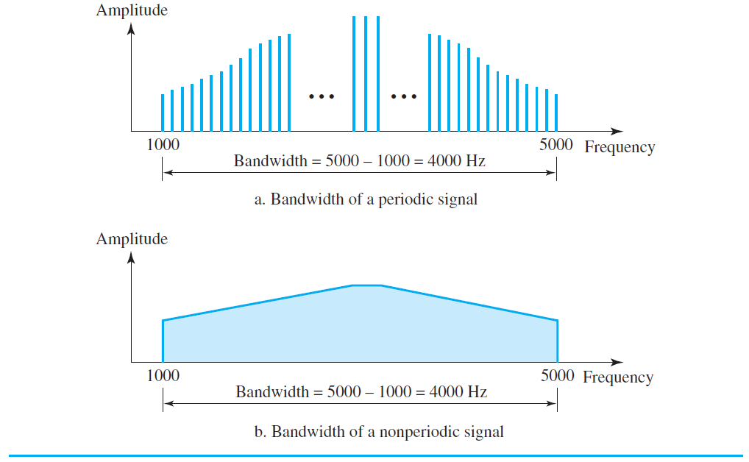
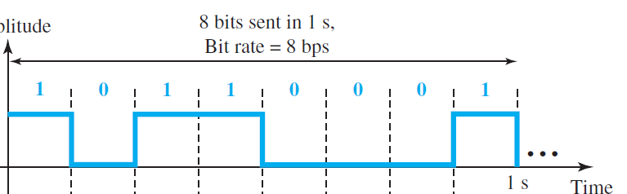
Bandwidth
In networking,
We use the term bandwidth in two contexts.
  The first, bandwidth in hertz,
  refers to the range of frequencies in a composite signal or the range of frequencies that a channel can pass.
  The second, bandwidth in bits per second, refers to the speed of bit transmission in a channel or link.

Slide 10
Baseline Wandering (Drifting)
  In decoding a digital signal, the receiver calculates a running average of the received signal power.
  This average is called the baseline.
  The incoming signal power is evaluated against this baseline to determine the value of the data element.
  A long string of 0s or 1s can cause a drift in the baseline and make it difficult for the receiver to decode correctly.

Slide 11
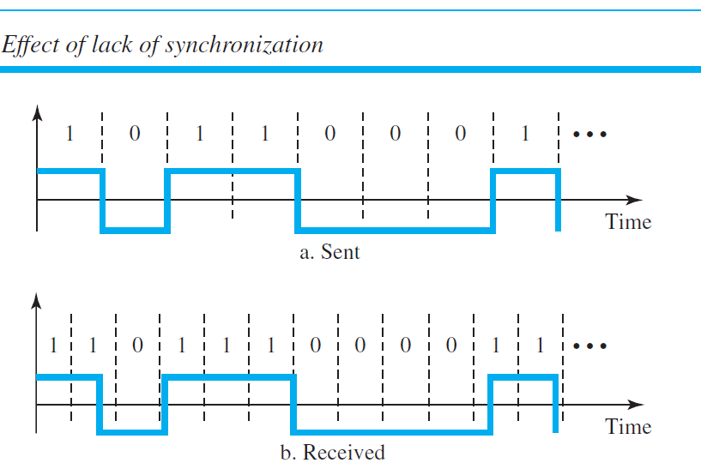
  Self-synchronization

Slide 12
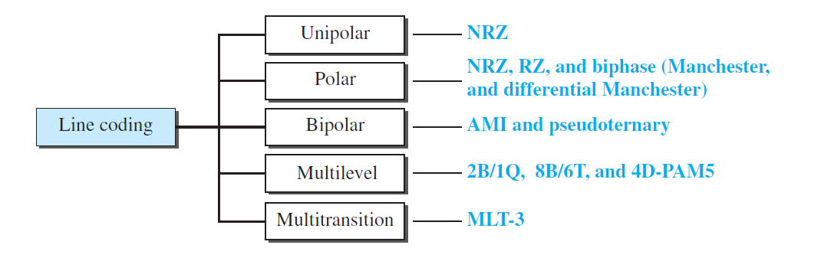
Line Coding Schemes
Unipolar Scheme
  In a unipolar scheme, all the signal levels are on one side of the time axis, either above or below.

Slide 13
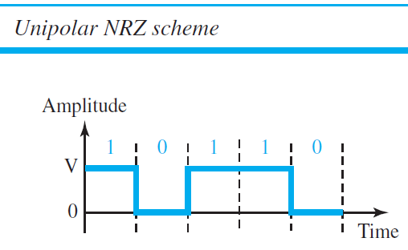
Unipolar NRZ
NRZ (Non-Return-to-Zero)
  Traditionally, a unipolar scheme was designed as a non-return-to-zero (NRZ) scheme in which the positive voltage defines bit 1 and the zero voltage defines bit 0.
  It is called NRZ because the signal does not return to zero at the middle of the bit.

Slide 14
Polar Scheme
In polar schemes, the voltages are on both sides of the time axis.
  For example, the voltage level for 0 can be positive and the voltage level for 1 can be negative
In polar NRZ encoding, we use two levels of voltage amplitude.
We can have two versions of polar NRZ:
  NRZ-L (NRZ-Level) and
  NRZ-I (NRZ-Invert),

Slide 15
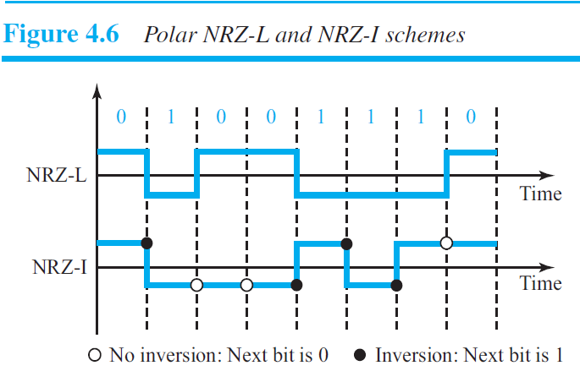
NRZ-I (NRZ-Invert), the change or lack of change in the level of the voltage determines the value of the bit.
If there is no change, the bit is 0; if there is a change, the bit is 1.

Slide 16
Return-to-Zero (RZ)
  The main problem with NRZ encoding occurs when the sender and receiver clocks are not synchronized
  One solution is the return-to-zero (RZ) scheme, which uses three values:
  positive, negative, and zero.

Slide 17
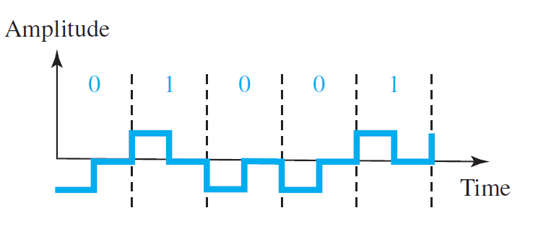
In RZ, the signal changes not between bits but during the bit.
the signal goes to 0 in the middle of each bit.
It remains there until the beginning of the next bit.
The main disadvantage of RZ encoding is that: it requires two signal changes to encode a bit and therefore occupies greater bandwidth.

Slide 18
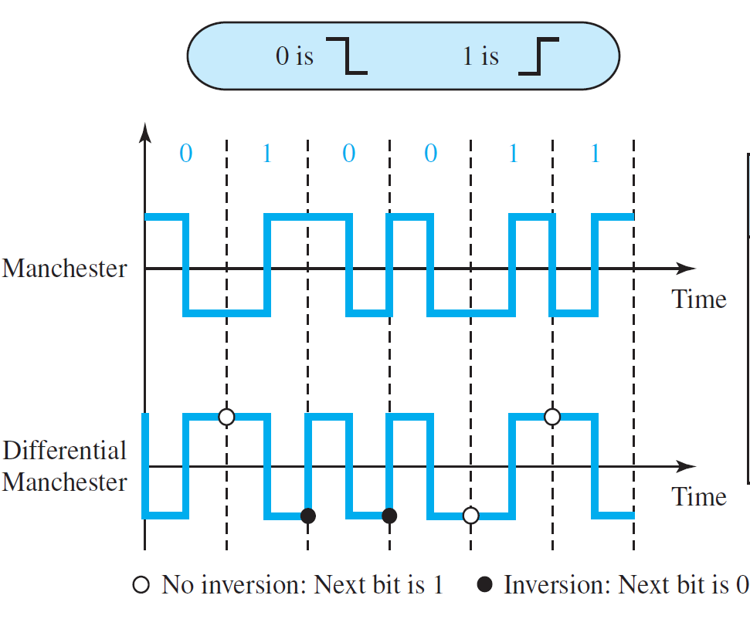
Biphase: Manchester and Differential Manchester
The idea of RZ (transition at the middle of the bit) and the idea of NRZ-L are combined into the Manchester scheme.
In Manchester encoding, the duration of the bit is divided into two levels.
The voltage remains at one level during the first half and moves to the other level in the second half.
The transition at the middle of the bit provides synchronization

Slide 19
Biphase: Manchester and Differential Manchester
Differential Manchester, on the other hand, combines the ideas of RZ and NRZ-I. There is always a transition at the middle of the bit, but the bit values are determined at the beginning of the bit.
There is always a transition at the middle of the bit, but the bit values are determined at the beginning of the bit.
If the next bit is 0, there is a transition;
if the next bit is 1, there is none.

